Slide 1
Artificial Intelligence Lecture No. 8

Slide 2
Summary of Previous Lecture
Types of search Algorithms
Uninformed Search
Informed Search
Breadth-first searching
Depth-first search

Slide 3
Today’s Lecture
Informed (Heuristic) search
Heuristic evaluation function
Greedy Best-First Search
A* Search

Slide 4
Informed (Heuristic) search
Heuristic search is an AI search technique that employs heuristic for its moves.
Heuristic is a rule of thumb that probably leads to a solution.
Heuristics play a major role in search strategies because of exponential nature of the most problems. Heuristics help to reduce the number of alternatives from an exponential number to a polynomial number.

Slide 5
Heuristic search
In Artificial Intelligence, heuristic search has a general meaning, and a more specialized technical meaning.
In a general sense, the term heuristic is used for any advice that is often effective, but is not guaranteed to work in every case.
Within the heuristic search architecture, however, the term heuristic usually refers to the special case of a heuristic evaluation function.

Slide 6
Heuristic information
In order to solve larger problems, domain-specific knowledge must be added to improve search efficiency.
Information about the problem include the nature of states, cost of transforming from one state to another, and characteristics of the goals.
This information can often be expressed in the form of heuristic evaluation function, say f(n,g), a function of the nodes n and/or the goals g.

Slide 7
Heuristic evaluation function
Heuristic evaluation function estimates the cost of an optimal path between a pair of states in a single-agent path-finding problem, .
For example, Euclidean or airline distance is an estimate of the highway distance between a pair of locations.

Slide 8
Manhattan Distance
Manhattan distance is a common heuristic function for the sliding-tile puzzles.
Manhattan distance is computed by counting the number of moves along the grid that each tile is displaced from its goal position, and summing these values over all faces.

Slide 9
Heuristic evaluation function
For a fixed goal state, a heuristic evaluation is a function of a node, say h(n), that estimates the distance from node, say n to the given state.
h(n) = estimated cost of the cheapest path from node n to a goal node
There is a whole family of Best-First Search algorithms with different evaluation functions
Each has a heuristic function h(n)

Slide 10
Following is a list of heuristic search techniques…
Greedy best-first search
A* search
Recursive best-first search
Pure Heuristic Search
Iterative-Deepening A*
Depth-First Branch-And-Bound
Heuristic Path Algorithm

Slide 11
Greedy Best-First Search
Greedy Best-First search tries to expand the node that is closest to the goal assuming it will lead to a solution quickly
f(n) = h(n)
“Greedy Search”
to refer specifically to a search with a heuristic that attempts to predict how close the end of a path is to a solution, so that paths which are judged to be closer to a solution are extended first. This specific type of search is called greedy best-first search.
Implementation
expand the “most desirable” node into the fringe queue
sort the queue in decreasing order of desirability
Example: consider the straight-line distance heuristic h_{SLD}
Expand the node that appears to be closest to the goal

Slide 12
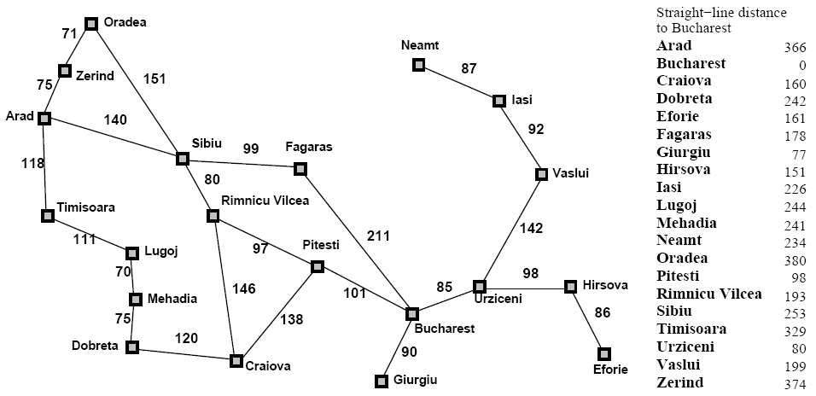
Greedy Best-First Search

Slide 13
Greedy Best-First Search
h_{SLD}(In(Arid)) = 366
Notice that the values of h_{SLD} cannot be computed from the problem itself
It takes some experience to know that h_{SLD} is correlated with actual road distances
Therefore a useful heuristic

Slide 14
Greedy Best-First Search

Slide 15
Greedy Best-First Search

Slide 16
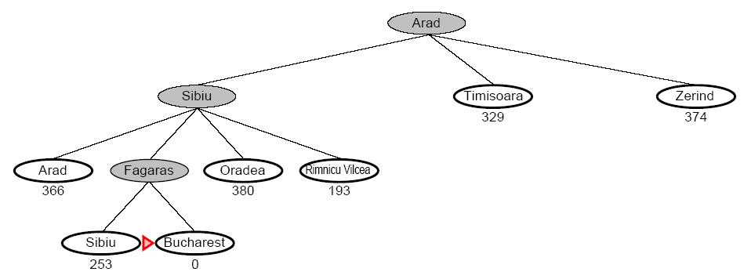
Greedy Best-First Search

Slide 17
Greedy Best-First Search
Complete
No, GBFS can get stuck in loops (e.g. bouncing back and forth between cities)
Time
O(b^{m}) but a good heuristic can have dramatic improvement
Space
O(b^{m}) – keeps all the nodes in memory
Optimal
No!

Slide 18
Robot Navigation

Slide 19
Robot Navigation
f(N) = h(N), with h(N) = Manhattan distance to the goal
8
7
6
5
4
3
2
3
4
5
6
7
5
4
3
5
6
3
2
1
0
1
2
4
7
6
5
8
7
6
5
4
3
2
3
4
5
6

Slide 20
Robot Navigation
f(N) = h(N), with h(N) = Manhattan distance to the goal
8
7
6
5
4
3
2
3
4
5
6
7
5
4
3
5
6
3
2
1
0
0
1
2
4
7
What happened???
7
6
5
8
7
6
5
4
3
2
3
4
5
6

Slide 21
A* Search
A* algorithm is a best-first search algorithm in which the cost associated with a node is
f(n) = g(n) + h(n),
where g(n) is the cost of the path from the initial state to node n and h(n) is the heuristic estimate or the cost or a path from node n to a goal.
Thus, f(n) estimates the lowest total cost of any solution path going through node n. At each point a node with lowest f value is chosen for expansion.
Ties among nodes of equal f value should be broken in favor of nodes with lower h values. The algorithm terminates when a goal is chosen for expansion.

Slide 22
A* Search
A* (A star) is the most widely known in AI
It evaluates nodes by combining g(n) and h(n)
f(n) = g(n) + h(n)
Where
g(n) = cost so far to reach n
h(n) = estimated cost to goal from n
f(n) = estimated total cost of path through n

Slide 23
A* Search
When h(n) = actual cost to goal
Only nodes in the correct path are expanded
Optimal solution is found
When h(n) < actual cost to goal
Additional nodes are expanded
Optimal solution is found
When h(n) > actual cost to goal
Optimal solution can be overlooked

Slide 24
Greedy Best-First Search

Slide 25
A* Search

Slide 26
A* Search

Slide 27
A* Search

Slide 28
A* Search

Slide 29
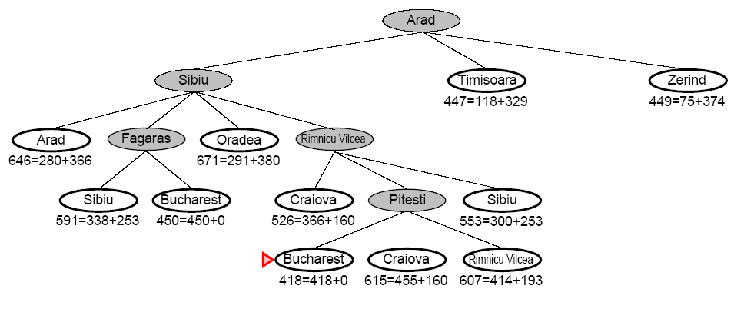
A* Search

Slide 30
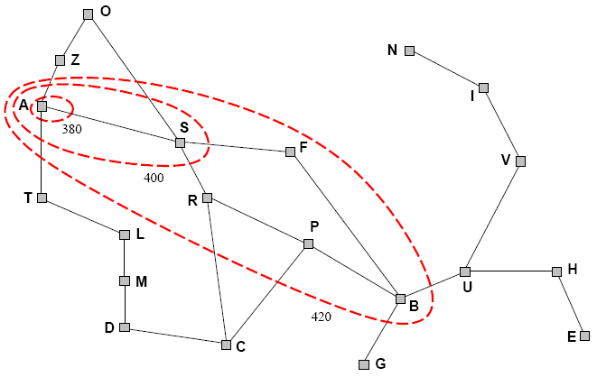
A* Search
A* expands nodes in increasing f value
Gradually adds f-contours of nodes (like breadth-first search adding layers)
Contour i has all nodes f=f_{i} where f_{i} < f_{i+1}

Slide 31
A* Search
Complete
Yes, unless there are infinitely many nodes with f <= f(G)
Time
Exponential in [relative error of h x length of soln]
The better the heuristic, the better the time
Best case h is perfect, O(d)
Worst case h = 0, O(b^{d}) same as BFS
Space
Keeps all nodes in memory and save in case of repetition
This is O(b^{d}) or worse
A* usually runs out of space before it runs out of time
Optimal
Yes, cannot expand f_{i+1} unless f_{i} is finished

Slide 32
Once more
We kept looking at nodes closer and closer to the goal, but were accumulating costs as we got further from the initial state
Our goal is not to minimize the distance from the current head of our path to the goal, we want to minimize the overall length of the path to the goal!
Let g(N) be the cost of the best path found so far between the initial node and N
f(N) = g(N) + h(N)

Slide 33
Robot Navigation
f(N) = g(N)+h(N), with h(N) = Manhattan distance to goal
8+3
8+3
7+4
7+4
6+5
6+3
5+6
5+6
4+7
4+7
3+8
3+8
2+9
8
7
6
5
4
3
2+9
3+10
2
3
4
5
6
7+2
7+2
5+6
4+7
3+8
7
5
4
3+8
3
5
6+1
6+1
2+9
2+9
1+10
6
3
2
1+10
0+11
1
0
1
2
4
7+0
7+0
6+1
7
6+1
6
5
8+1
8+1
7+2
7+2
6+3
6+3
5+4
5+4
4+5
4+5
3+6
3+6
2+7
8
7
6
5
4
3
2+7
3+8
2
3
4
5
6

Slide 34
Complexity Of Finding Optimal Solutions
The time complexity of a heuristic search algorithm depends on the accuracy of the heuristic function.
For example, if the heuristic evaluation function is an exact estimator, then A* search algorithm runs in linear time, expanding only those nodes on an optimal solution path.
Conversely, with a heuristic that returns zero everywhere, A* algorithm becomes uniform-cost search, which has exponential complexity.

Slide 35
Summery of Today’s Lecture
Informed (Heuristic) search
Heuristic evaluation function
Greedy Best-First Search
A* Search

